Slide 1
Soap carving

Slide 2
Introduction
Carving is generally the act of shaping something from the materials by scraping some portions with the help of the available tools.

Slide 3
First, place a bar of soap on a sheet of paper and trace its outline. Within the outline on the paper, draw your design and cut it out. Place the design on the bar of soap. Then, use a pencil to lightly carve the outline of your design into the soap.

Slide 4
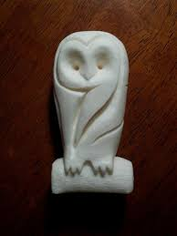
For example

Slide 5
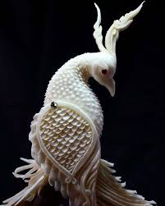

Slide 6
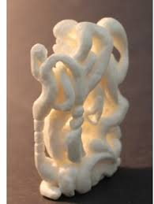

Slide 7
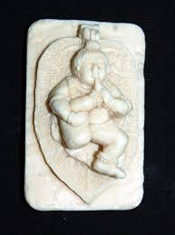

Slide 8
